Slide 1
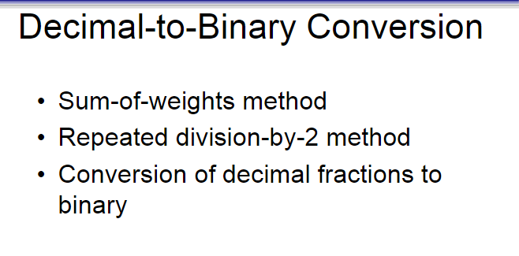

Slide 2
Sum-of-Weights Method
This method uses the fact that any decimal number can be expressed as a sum of powers of 2.
Example: Convert 13 to binary
Powers of 2: 8 (2³), 4 (2²), 1 (2⁰)
13 = 8 + 4 + 1 → 2³ + 2² + 2⁰
So, binary: 1101
8 4 2 1
13 =
1 1 0 1
9 =
1 0 0 1

Slide 3
Repeated Division-by-2 Method
Divide the number by 2 and record the remainder. Read remainders from bottom to top.
Example: Convert 13 to binary
Division | Quotient | Remainder
13 ÷ 2 | 6 | 1
6 ÷ 2 | 3 | 0
3 ÷ 2 | 1 | 1
1 ÷ 2 | 0 | 1
13 = 1 1 0 1

Slide 4
Conversion of Decimal Fractions to Binary
Multiply the fractional part by 2.
Take the integer part as a bit and continue with the fractional part.
Example: Convert 0.625 to binary
Multiply | Integer Part | Fraction
0.625 × 2 = 1.25 | 1 | 0.25
0.25 × 2 = 0.5 | 0 | 0.5
0.5 × 2 = 1.0 | 1 | 0.0
0.625 to binary =0.101

Slide 5
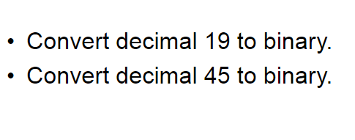
Convert 0.3125 to binary

Slide 6
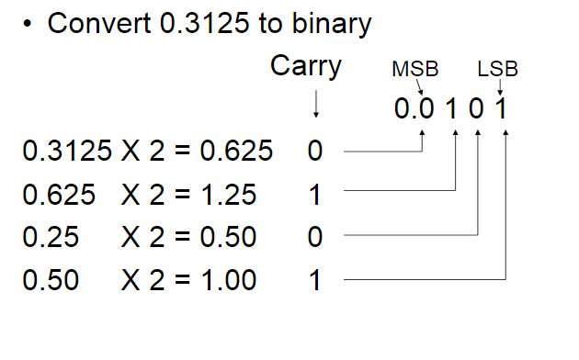
.
(MSB )Most Significant Bit
It is the leftmost bit in the binary number
Eg: 0. 0 1 0 1
(LSB )Least Significant Bit
It is the rightmost bit in the binary number.
Eg: 0. 0 1 0 1
MSB
LSB

Slide 7
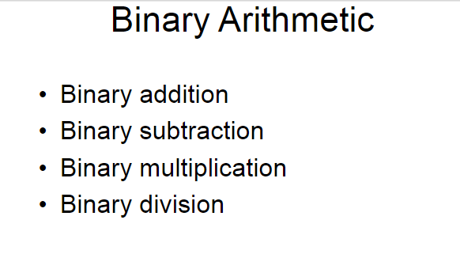

Slide 8
Binary Addition
0 + 0 = 0
0 + 1 = 1
1 + 0 = 1
1 + 1 = 10 (carry 1)
Binary Subtraction
0 - 0 = 0
1 - 0 = 1
1 - 1 = 0
0 - 1 = 1 (borrow 1)
)
Binary Multiplication
0 × 0 = 0
0 × 1 = 0
1 × 0 = 0
1 × 1 = 1
Binary Division
0 / 0 = Undefined
0 / 1 = 0
1 / 0 = Undefined
1 / 1 = 1

Slide 9
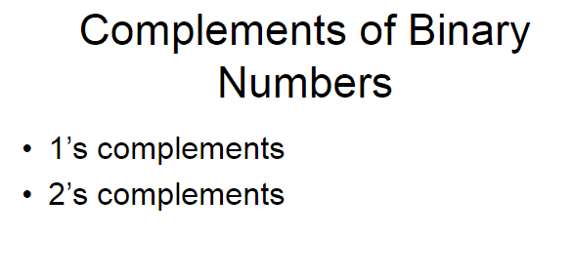

Slide 10
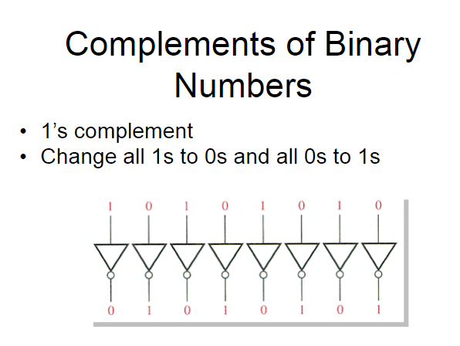
Example : 00010110
1’ s Complement : 0 0 0 1 0 1 1 0
1 1 1 0 1 0 0 1

Slide 11
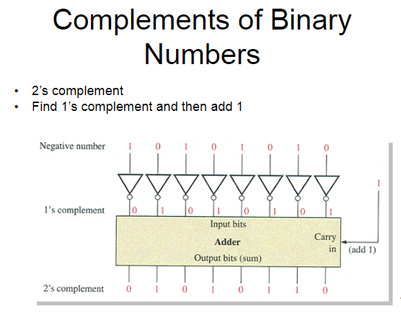

Slide 12
2’S COMPLEMENT
Steps to Find 2’s Complement:
Find the 1’s complement (flip all bits)
Add 1 to the result
Example: Convert 22 to -22 in 8-bit binary
Step 1: 22 in binary (8-bit) =
Division Step | Remainder
22 ÷ 2 | 0
11 ÷ 2 | 1
5 ÷ 2 | 1
2 ÷ 2 | 0
1 ÷ 2 | 1
=10110
= 00010110 (8 bits)

Slide 13
Step 2: Find 1’s complement (flip bits) =
00010110
11101001

Slide 14
Step 3: Find 2’s complement (Add 1) =
11101001
1 +
11101010

Slide 15
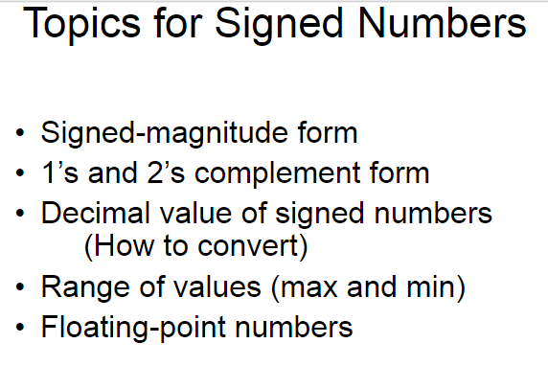

Slide 16
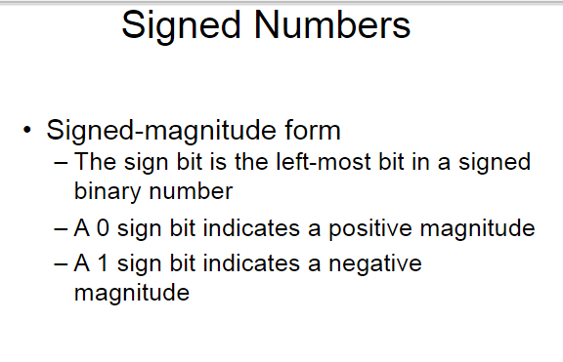

Slide 17
Signed-Magnitude Form
The leftmost bit is the sign bit.
The remaining bits represent the magnitude (absolute value).
Sign Bit | Meaning
0 | Positive (+)
1 | Negative (−)

Slide 18
Decimal | Binary (Signed-Magnitude) | Explanation
+5 | 0 101 | 0 → positive, 101 = 5
-5 | 1 101 | 1 → negative, 101 = 5
Sign Bit
Sign Bit

Slide 19
RANGE OF NUMBERS (N-BIT)
In n-bit signed-magnitude:
We can represent values from: – (2ⁿ⁻¹ – 1) to +(2ⁿ⁻¹ – 1)
0 has two forms:
0000 → +0
1000 → –0 (redundant)
For 4-bit: range is –7 to +7 (–7: 1111, +7: 0111)

Slide 20
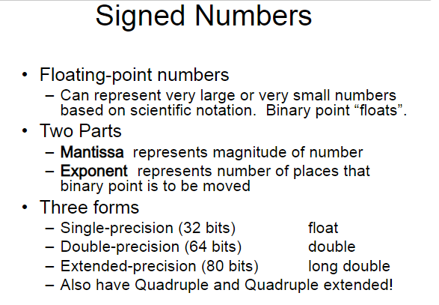

Slide 21
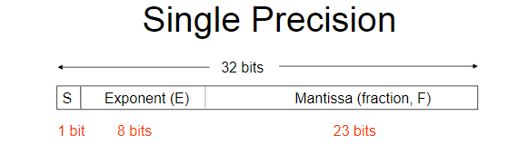
Example :Convert 20₁₀ to IEEE 754 Single Precision
Step 1: Convert to Binary
Use divide by 2 method:
20 ÷ 2 = 10 → 0
10 ÷ 2 = 5 → 0
5 ÷ 2 = 2 → 1
2 ÷ 2 = 1 → 0
1 ÷ 2 = 0 → 1

Slide 22
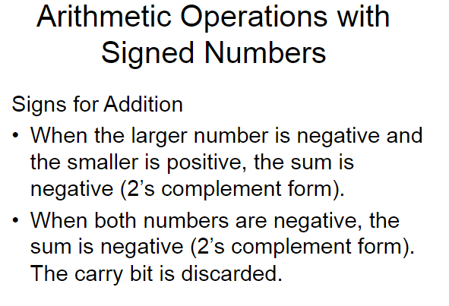
Addition
Subtraction
Multiplication
Division

Slide 23
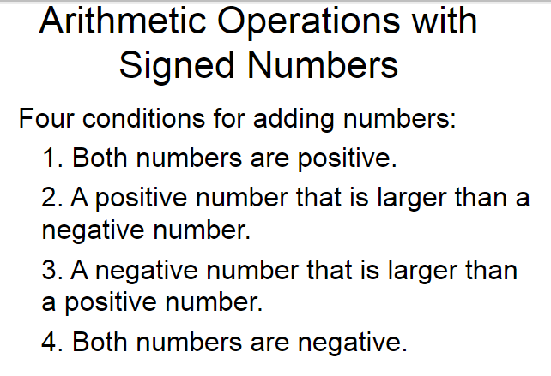
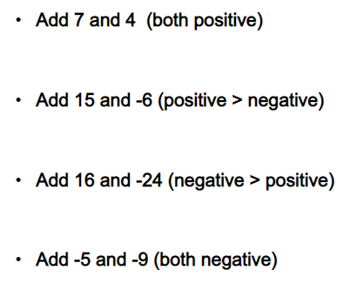

Slide 24
Addition of Signed Numbers
Let’s use 2's complement (most common method in computers)
Problem: Add +5 and -3 in 4-bit binary
Represent numbers in 2's complement
+5 = 0101
-3:
3 in binary = 0011
1’s complement = 1100
2’s complement = 1101
(this is -3)
0101 (+5)
+
1101 (-3)
--------
10010
Result = 0010 = 2

Slide 25
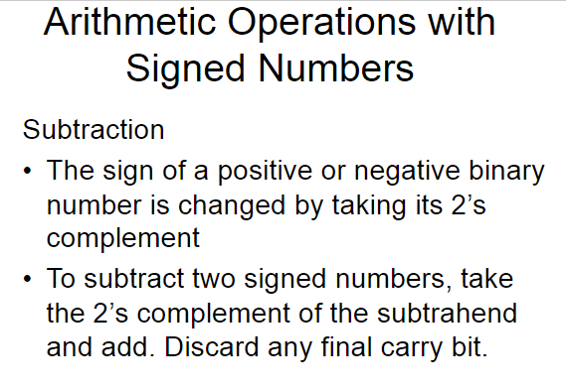
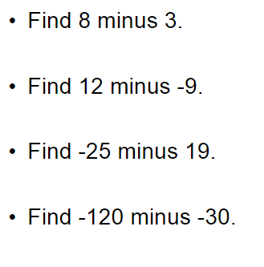

Slide 26
Subtraction of Signed Numbers
Problem: 5 - 7 = ?
Convert to: 7 +(-5)
+7 = 0111
+5= 0101
→ 1's complement = 1010
→ 2's complement +1 = 1011 – (-5)
0111 (7)
+ 1011 (-5)
-------
10010
Result = 2 → 0010

Slide 27
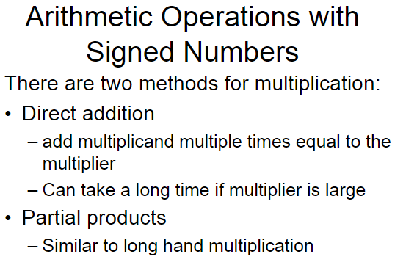
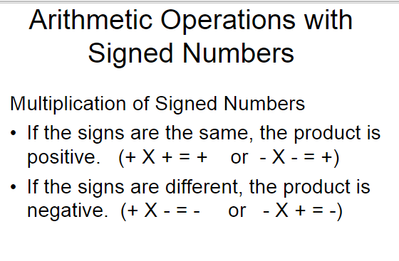

Slide 28
Multiplication
Example: Multiply -3 × 2 using 4-bit 2’s complement
Represent in 4-bit binary:
+2 : 0010
-3 :0011
→ 1’s comp: 1100
→ 2’s comp (+1) = 1101
1101 (−3)
× 0010 (+2)
----------
00000010
Result = 1110 (in 4-bit signed: this is -6)

Slide 29
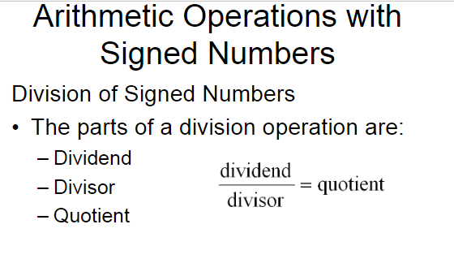
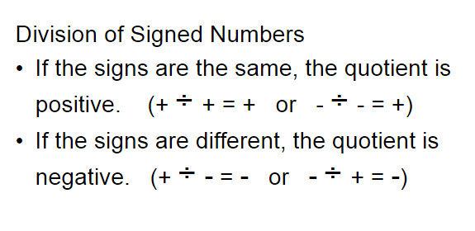

Slide 30
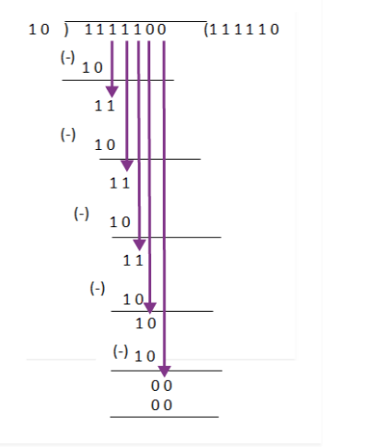
Division
Example: 01111100 ÷ 0010

Slide 31
QUESTIONS
Which of the following values is the correct value of this binary code 1011 and 1111?
11 and 14
12 and 15
c. 11 and 15
d. 12 and 14

Slide 32
Which of the following numbers is a binary number?
1 and 2
0 and 0.1
2 and 0
0 and 1
Binary equivalent of decimal number 25 is
11101
11001
10011
11111

Slide 33
2’s Complement of (10000 )2 is
10000
01111
11000
01000

